Slide 1




Noida Institute of Engineering and Technology, Greater Noida
Structural Design Pattern
Unit: 3
Design Pattern(ACSE0514)
Structural Design Pattern
Renu Panwar
Assistant Professor
CSE(AIML)
Course Details (B Tech 5th Sem)

Slide 2
Faculty Introduction
Name | Renu Panwar
Qualification | B.Tech (CSE),M. Tech. (CSE)
Designation | Assistant Professor
Department | Computer Science & Engineering-AIML
Total Experience | 12 years
NIET Experience | 5.5 years
Subject Taught | Core Java and Advance Java, Artificial Intelligence, Soft Computing, C Programming, Web Technology, Operating System, Machine Learning, Deep Learning,design Pattern

Slide 3
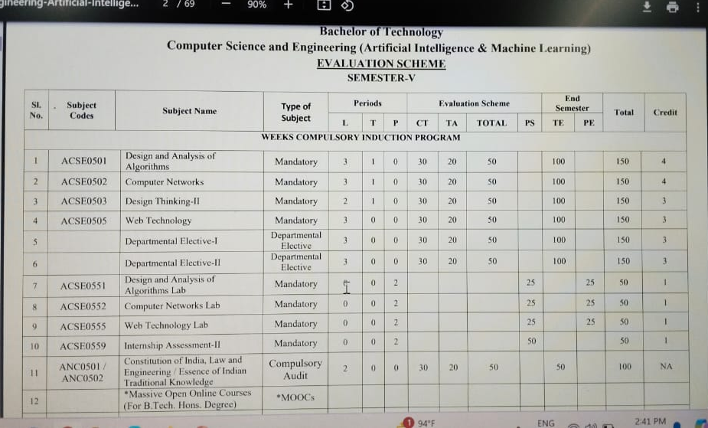
Evaluation Scheme

Slide 4
Syllabus
UNIT-III: Structural Design Pattern
Structural Pattern Part-I, Adapter, Bridge, Composite.
Structural Pattern Part-II, Decorator, Facade, Flyweight, Proxy.

Slide 5
Design Pattens Application
1. Real-time web analytics
2. Digital Advertising
3. E-Commerce
4. E-Publishing
5. Massively Multiplayer Online Games
6. Backend Services and Messaging
7. Project Management & Collaboration
8. Real time Monitoring Services
9.Live Charting and Graphing
10. Group and Private Chat

Slide 6
Course Objective
In this semester, the students will
Study how to show relationships and interactions between classes or objects.
Study to speed up the development process by providing well-tested, proven development/design paradigms.
Select a specific design pattern for the solution of a given design problem.
Create a catalog entry for a simple design pattern whose purpose and application are understood.

Slide 7
Course Outcomes
At the end of course, the student will be able to:
CO1 : Construct a design consisting of collection of modules.
CO2 : Exploit well known design pattern such as Factory, visitor etc.
CO3 : Distinguish between different categories of design patterns.
CO4 : Ability to common design pattern for incremental development.
CO5 : Identify appropriate design pattern for a given problem and design the software using pattern oriented architecture.

Slide 8
Program Outcomes (POs)
Engineering Graduates will be able to:
PO1 : Engineering Knowledge
PO2 : Problem Analysis
PO3 : Design/Development of solutions
PO4 : Conduct Investigations of complex problems
PO5 : Modern tool usage
PO6 : The engineer and society

Slide 9
Program Outcomes (POs)
Engineering Graduates will be able to:
PO7 : Environment and sustainability
PO8 : Ethics
PO9 : Individual and teamwork
PO10 : Communication
PO11 : Project management and finance
PO12 : Life-long learning

Slide 10
COs - POs Mapping
CO.K | PO1 | PO2 | PO3 | PO4 | PO5 | PO6 | PO7 | PO8 | PO9 | PO10 | PO11 | PO12
CO1 | 2 | 2 | 2 | 3 | 3 | - | - | - | - | - | - | -
CO2 | 3 | 2 | 3 | 2 | 3 | - | - | - | - | - | - | -
CO3 | 3 | 2 | 3 | 2 | 3 | - | - | - | - | - | - | -
CO4 | 3 | 2 | 3 | 2 | 3 | - | - | - | - | - | - | -
CO5 | 3 | 2 | 3 | 3 | 3 | - | - | - | - | - | - | -
AVG | 2.8 | 2.0 | 2.8 | 2.4 | 3.0 | - | - | - | - | - | - | -

Slide 11
Program Specific Outcomes(PSOs)
S. No. | Program Specific Outcomes (PSO) | PSO Description
1 | PSO1 | Understand to shows relationships and interactions between classes or objects of a pattern.
2 | PSO2 | Study to speed up the development process by providing well-tested, proven development
3 | PSO3 | Select a specific design pattern for the solution of a given design problem
4 | PSO4 | Create a catalogue entry for a simple design pattern whose purpose and application is understood.

Slide 12
COs - PSOs Mapping
CO.K | PSO1 | PSO2 | PSO3 | PSO4
CO1 | 3 | - | - | -
CO2 | 3 | 3 | - | -
CO3 | 3 | 3 | - | -
CO4 | 3 | 3 | - | -
CO5 | 3 | 3 | - | -

Slide 13
Program Educational Objectives (PEOs)
Program Educational Objectives (PEOs) | PEOs Description
PEOs | To have an excellent scientific and engineering breadth so as to comprehend, analyze, design and provide sustainable solutions for real-life problems using state-of-the-art technologies.
PEOs | To have a successful career in industries, to pursue higher studies or to support entrepreneurial endeavors and to face the global challenges.
PEOs | To have an effective communication skills, professional attitude, ethical values and a desire to learn specific knowledge in emerging trends, technologies for research, innovation and product development and contribution to society.
PEOs | To have life-long learning for up-skilling and re-skilling for successful professional career as engineer, scientist, entrepreneur and bureaucrat for betterment of society.

Slide 14
Result Analysis(Department Result & Subject Result & Individual result
Name of the faculty | Subject code | Result % of clear passed
Ms.Renu Panwar | ACSE0514 | 99

Slide 15
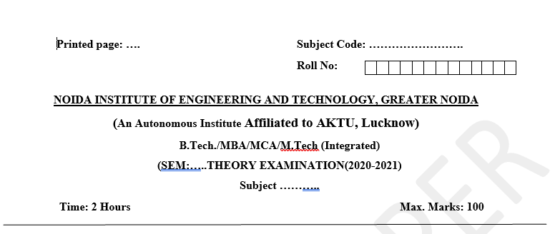
Pattern of Online External Exam Question Paper (100 marks)

Slide 16
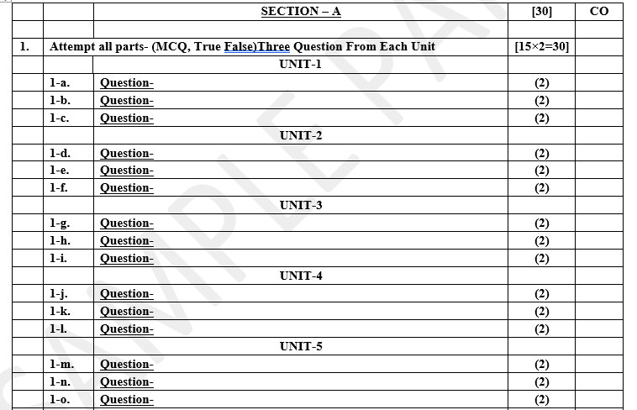
Pattern of Online External Exam Question Paper (100 marks)

Slide 17
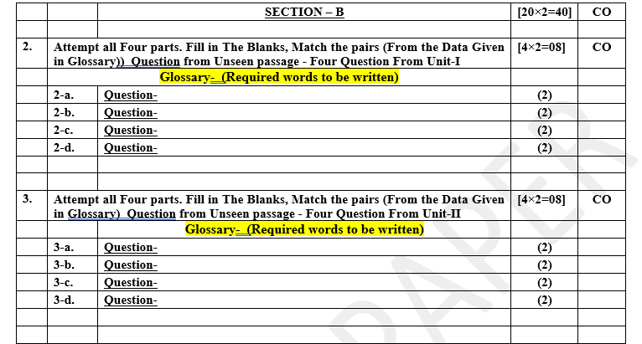
Pattern of Online External Exam Question Paper (100 marks)

Slide 18
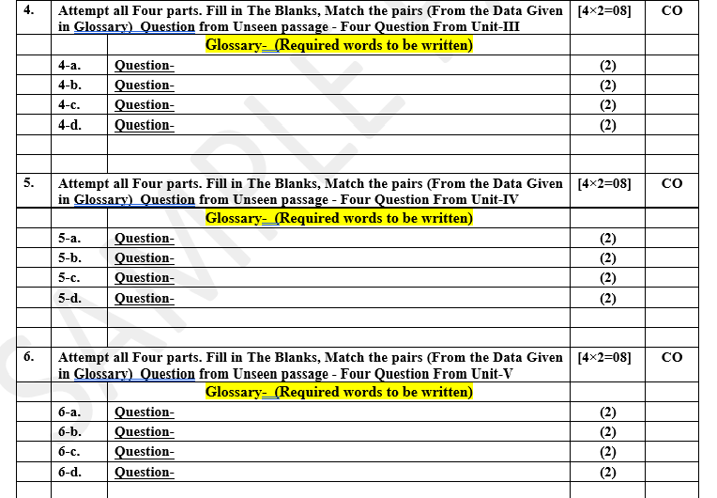
Pattern of Online External Exam Question Paper (100 marks)

Slide 19
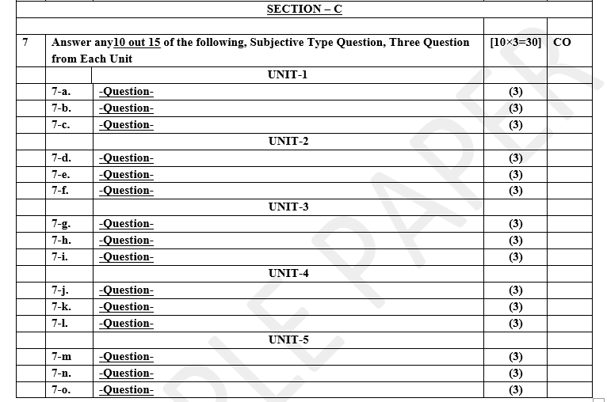
Pattern of Online External Exam Question Paper (100 marks)

Slide 20
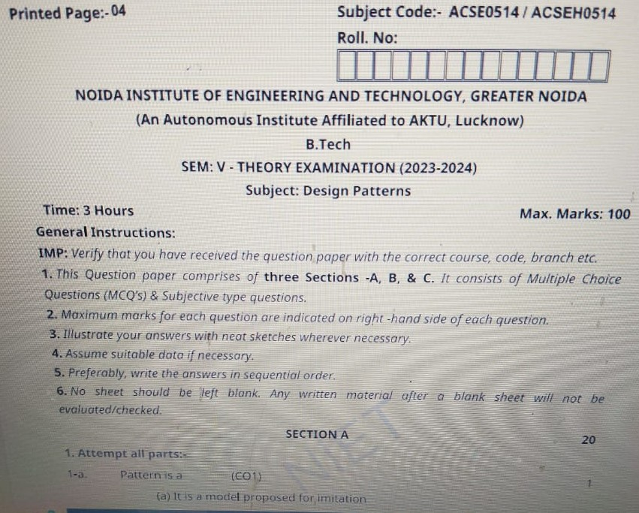
Design Pattern Previous Year Question Paper..

Slide 21
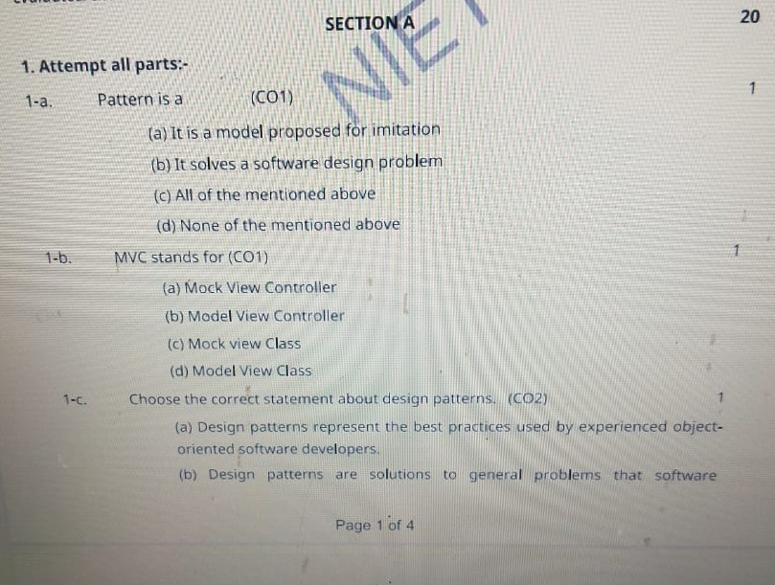
Design Pattern Previous Year Question Paper..

Slide 22
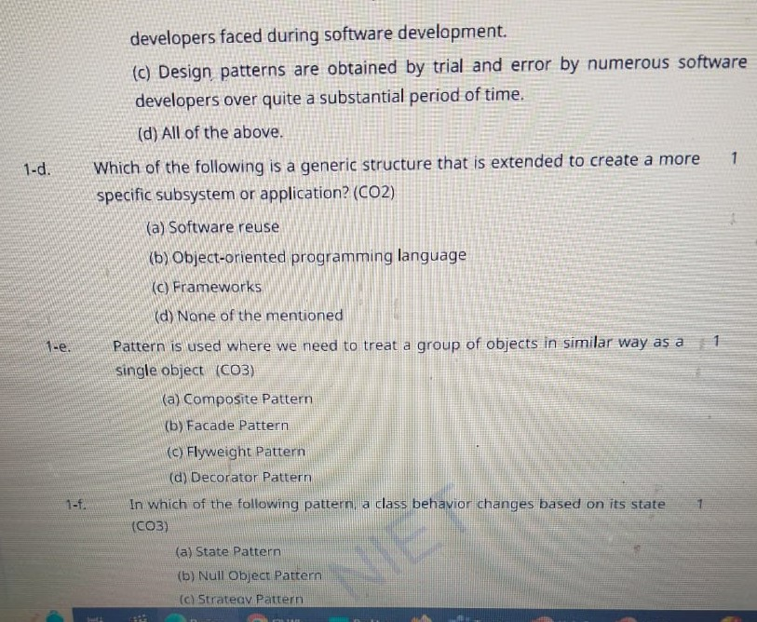
Design Pattern Previous Year Question Paper..

Slide 23
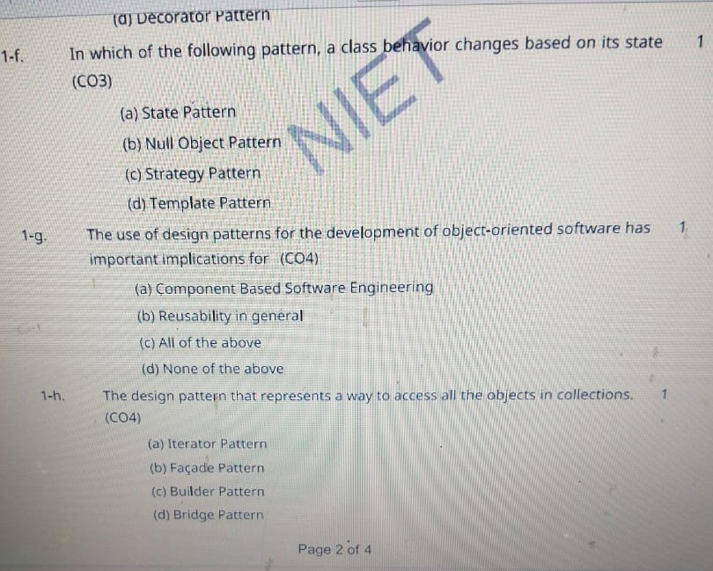
Design Pattern Previous Year Question Paper..

Slide 24
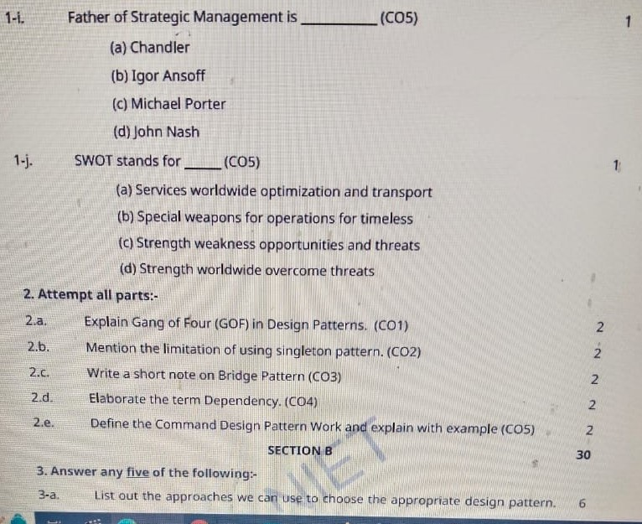
Design Pattern Previous Year Question Paper..

Slide 25
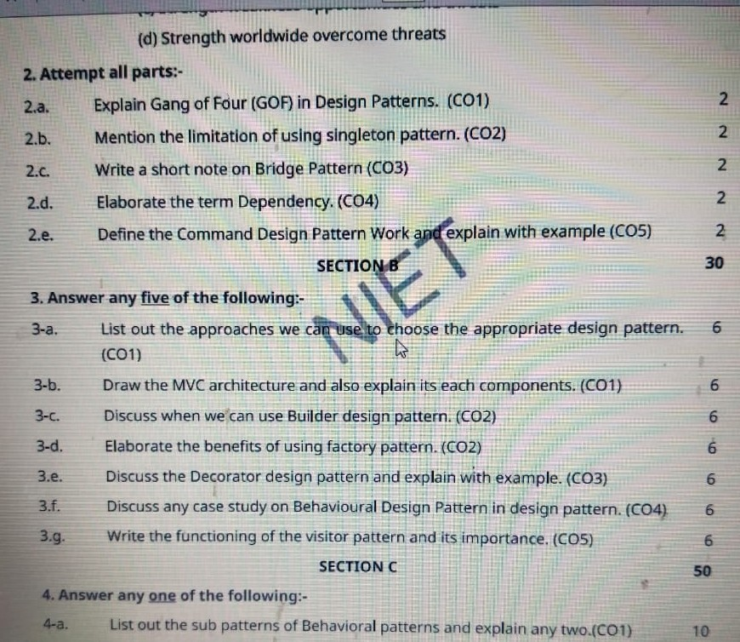
Design Pattern Previous Year Question Paper..

Slide 26
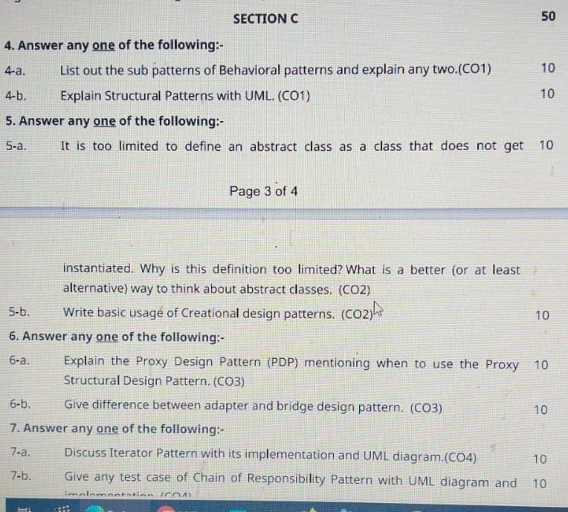
Design Pattern Previous Year Question Paper..

Slide 27
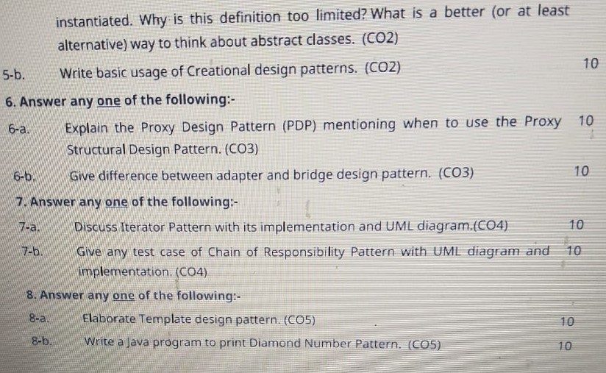
Design Pattern Previous Year Question Paper..

Slide 28
Prerequisite / Recap
Students should know object-oriented analysis and design.
Knowledge of Data structure and algorithm.
knowledge of Programming languages such as C/C++ etc.
Good problem-solving Skills.

Slide 29
Brief Introduction about the Subject with video
YouTube /other Video Links
https://youtu.be/rI4kdGLaUiQ?list=PL6n9fhu94yhUbctIoxoVTrklN3LMwTCmd
https://youtu.be/v9ejT8FO-7I?list=PLrhzvIcii6GNjpARdnO4ueTUAVR9eMBpc
https://youtu.be/VGLjQuEQgkI?list=PLt4nG7RVVk1h9lxOYSOGI9pcP3I5oblbx

Slide 30
Unit III Content
Structural Pattern Part-I :
Adapter Pattern
Bridge Pattern
Composite Pattern
Structural Pattern Part-II :
Decorator Pattern
Facade Pattern
Flyweight Pattern
Proxy Pattern

Slide 31
Structural Design Pattern…
Topic : Structural Pattern (Adapter)
In this topic, the students will gain , The idea of a Structural design pattern, It concerned with how classes and objects can be composed, to form larger structures. The structural design patterns simplifies the structure by identifying the relationships.

Slide 32
Structural Design Pattern
Structural design patterns:-
Structural design patterns are concerned with how classes and objects can be composed, to form larger structures.
The structural design patterns simplifies the structure by identifying the relationships.
These patterns focus on, how the classes inherit from each other and how they are composed from other classes.
structural design patterns are design patterns that ease the design by identifying a simple way to realize relationships among entities. Examples of Structural Patterns include Adapter pattern, Bridge, Composite etc.

Slide 33
Structural Design Pattern(Adapter Pattern)
Adapter Pattern:-
An Adapter Pattern says that just "converts the interface of a class into another interface that a client wants".
In other words, to provide the interface according to client requirement while using the services of a class with a different interface.
The Adapter Pattern is also known as Wrapper.
Advantage of Adapter Pattern:-
It allows two or more previously incompatible objects to interact.
It allows reusability of existing functionality.

Slide 34
Structural Design Pattern(Adapter Pattern)
Usage of Adapter pattern:-
It is used
When an object needs to utilize an existing class with an incompatible interface.
When you want to create a reusable class that cooperates with classes which don't have compatible interfaces.
When you want to create a reusable class that cooperates with classes which don't have compatible interfaces.

Slide 35
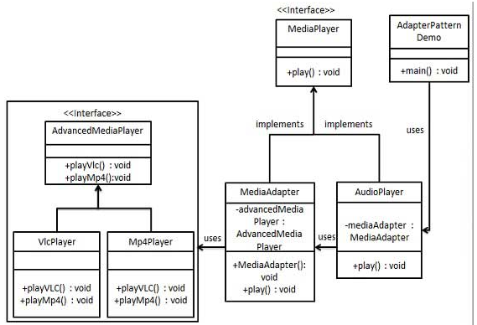
UML\Structure for Adapter Design Pattern

Slide 36
Implementation of (Adapter Design Pattern)
We have a MediaPlayer interface and a concrete class AudioPlayer implementing the MediaPlayer interface. AudioPlayer can play mp3 format audio files by default.
We are having another interface AdvancedMediaPlayer and concrete classes implementing the AdvancedMediaPlayer interface. These classes can play vlc and mp4 format files.
We want to make AudioPlayer to play other formats as well. To attain this, we have created an adapter class MediaAdapter which implements the MediaPlayer interface and uses AdvancedMediaPlayer objects to play the required format.
AudioPlayer uses the adapter class MediaAdapter passing it the desired audio type without knowing the actual class which can play the desired format. AdapterPatternDemo, our demo class will use AudioPlayer class to play various formats.

Slide 37
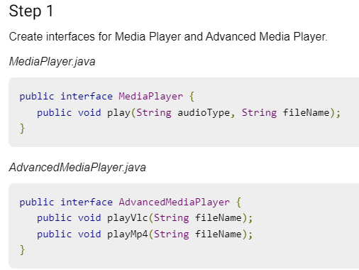
Implementation of (Adapter Design Pattern)

Slide 38
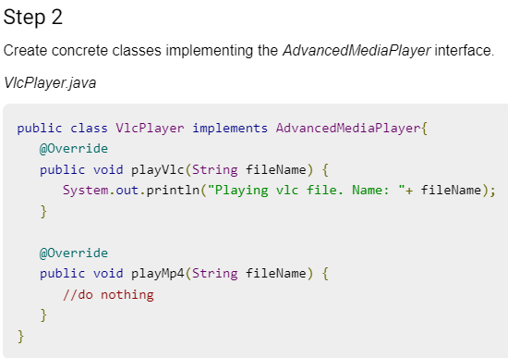
Implementation of (Adapter Design Pattern)

Slide 39

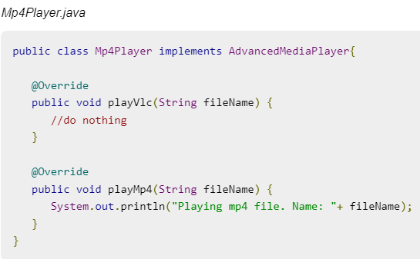
Implementation of (Adapter Design Pattern)

Slide 40
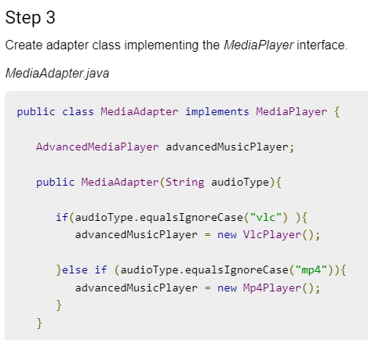
Implementation of (Adapter Design Pattern)

Slide 41

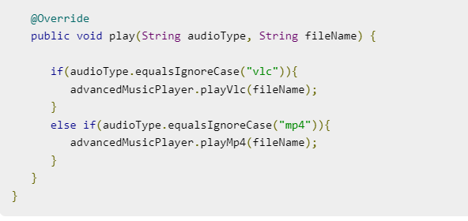
Implementation of (Adapter Design Pattern)

Slide 42
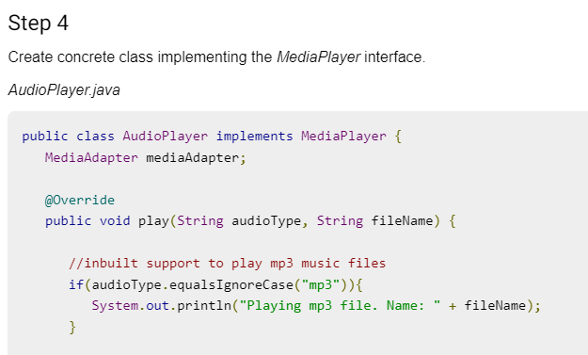
Implementation of (Adapter Design Pattern)

Slide 43

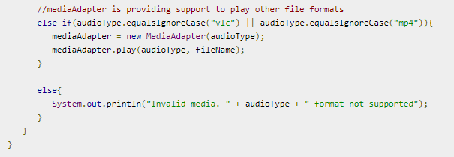
Implementation of (Adapter Design Pattern)

Slide 44
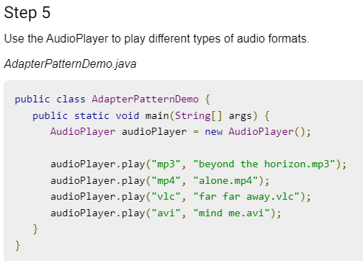
Implementation of (Adapter Design Pattern)

Slide 45
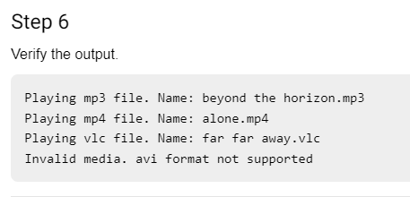
Implementation of (Adapter Design Pattern)

Slide 46
Topic Objective
Topic : Structural Pattern (Bridge Design Pattern)
In this topic, the students will gain , The idea of a Structural design pattern, It concerned with how classes and objects can be composed, to form larger structures. "decouple the functional abstraction from the implementation so that the two can vary independently".

Slide 47
Structural patterns (Bridge Pattern)
Bridge Design Pattern:-
A Bridge Pattern says that just "decouple the functional abstraction from the implementation so that the two can vary independently".
The Bridge Pattern is also known as Handle or Body. This pattern involves an interface which acts as a bridge which makes the functionality of concrete classes independent from interface implementer classes.
Bridge is used when we need to decouple an abstraction from its implementation so that the two can vary independently. This type of design pattern comes under structural pattern as this pattern decouples implementation class and abstract class by providing a bridge structure between them.

Slide 48
Structural patterns (Bridge Pattern)
Advantage of Bridge Pattern:-
It enables the separation of implementation from the interface.
It improves the extensibility.
It allows the hiding of implementation details from the client.
Usage of Bridge Pattern:-
When you don't want a permanent binding between the functional abstraction and its implementation.
When both the functional abstraction and its implementation need to extended using sub-classes.
It is mostly used in those places where changes are made in the implementation does not affect the clients.

Slide 49
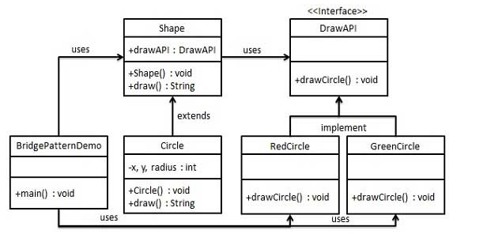
UML\Structure for Bridge Design Pattern

Slide 50
Implementation of (Bridge Design Pattern)
We are demonstrating use of Bridge pattern via following example in which a circle can be drawn in different colors using same abstract class method but different bridge implementer classes.
We have a DrawAPI interface which is acting as a bridge implementer and concrete classes RedCircle, GreenCircle implementing the DrawAPI interface. Shape is an abstract class and will use object of DrawAPI. BridgePatternDemo, our demo class will use Shape class to draw different colored circle.

Slide 51
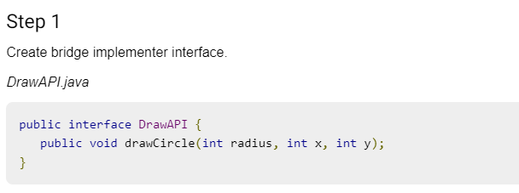
Implementation of (Bridge Design Pattern)

Slide 52
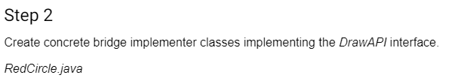
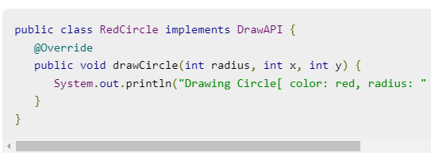
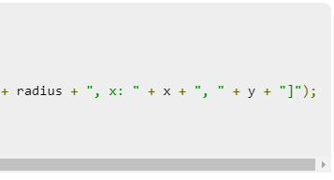
Implementation of (Bridge Design Pattern)

Slide 53
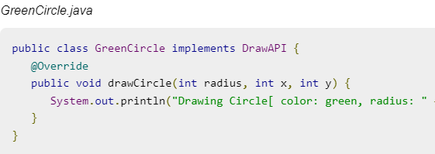
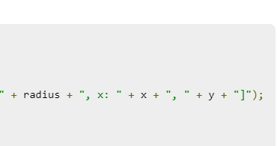
Implementation of (Bridge Design Pattern)

Slide 54
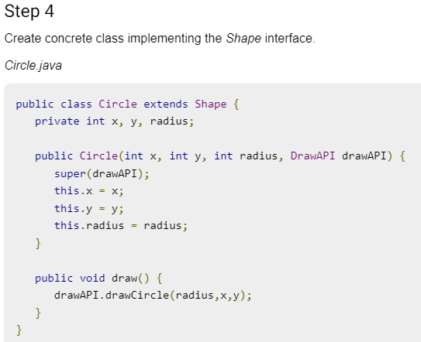
Implementation of (Bridge Design Pattern)

Slide 55
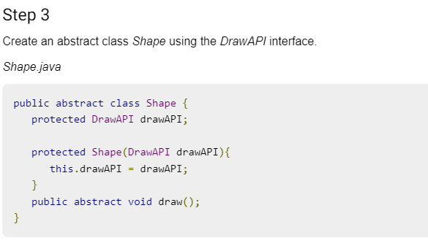
Implementation of (Bridge Design Pattern)

Slide 56
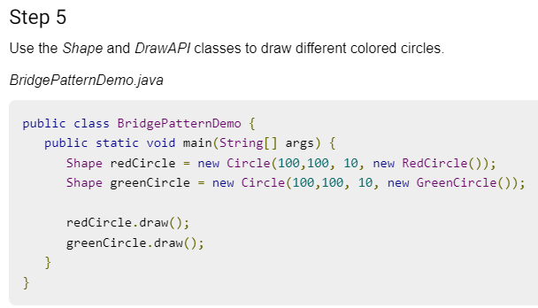
Implementation of (Bridge Design Pattern)

Slide 57
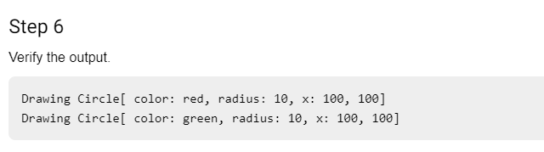
Implementation of (Bridge Design Pattern)

Slide 58
Structural patterns (Composite Pattern)
Composite Design Pattern:-
A Composite Pattern says that just "allow clients to operate in generic manner on objects that may or may not represent a hierarchy of objects".
Composite pattern is used where we need to treat a group of objects in similar way as a single object. Composite pattern composes objects in term of a tree structure to represent part as well as whole hierarchy. This type of design pattern comes under structural pattern as this pattern creates a tree structure of group of objects.
This pattern creates a class that contains group of its own objects. This class provides ways to modify its group of same objects.

Slide 59
Structural patterns (Composite Design Pattern)
Advantage of Composite Design Pattern:-
It defines class hierarchies that contain primitive and complex objects.
It makes easier to you to add new kinds of components.
It provides flexibility of structure with manageable class or interface.
Usage of Composite Design Pattern:-
It is used:
When you want to represent a full or partial hierarchy of objects.
When the responsibilities are needed to be added dynamically to the individual objects without affecting other objects. Where the responsibility of object may vary from time to time.

Slide 60
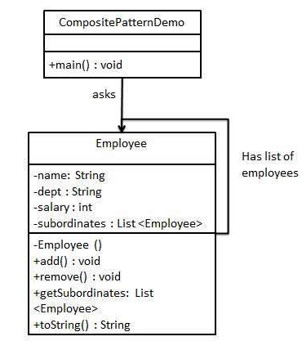
UML\Structure for Composite Design Pattern

Slide 61
Implementation of (Composite Design Pattern)
This pattern creates a class that contains group of its own objects. This class provides ways to modify its group of same objects.
We are demonstrating use of composite pattern via following example in which we will show employees hierarchy of an organization.
We have a class Employee which acts as composite pattern actor class. CompositePatternDemo, our demo class will use Employee class to add department level hierarchy and print all employees.

Slide 62

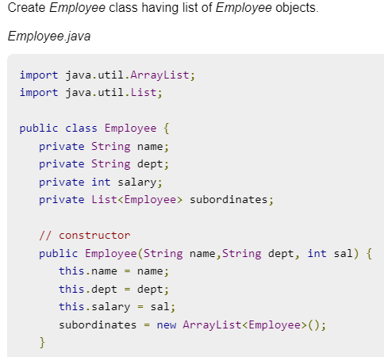
Implementation of (Composite Design Pattern)

Slide 63
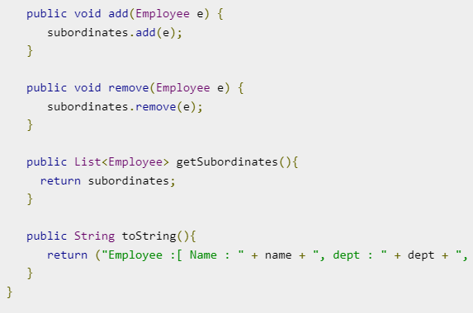

Implementation of (Composite Design Pattern)

Slide 64
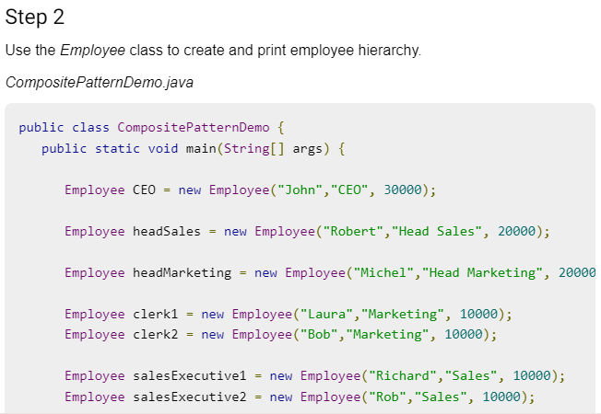
Implementation of (Composite Design Pattern)

Slide 65
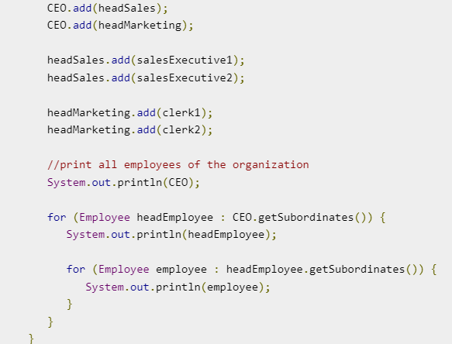
Implementation of (Composite Design Pattern)

Slide 66
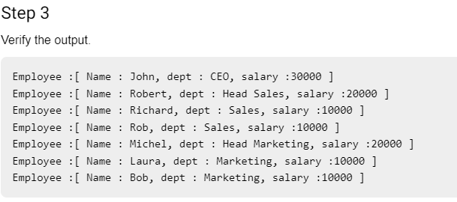
Implementation of (Composite Design Pattern)

Slide 67
Structural patterns II (Decorator Pattern)
Decorator Design Pattern:-
A Decorator Pattern says that just "attach a flexible additional responsibilities to an object dynamically".
In other words, The Decorator Pattern uses composition instead of inheritance to extend the functionality of an object at runtime. The Decorator Pattern is also known as Wrapper.
Decorator pattern allows a user to add new functionality to an existing object without altering its structure.
This pattern creates a decorator class which wraps the original class and provides additional functionality keeping class methods signature intact.

Slide 68
Structural patterns (Decorator Design Pattern)
Advantage of Decorator Design Pattern:-
It provides greater flexibility than static inheritance.
It enhances the extensibility of the object, because changes are made by coding new classes. It simplifies the coding by allowing you to develop a series of functionality from targeted classes instead of coding all of the behavior into the object.
Usage of Decorator Design Pattern:-
It is used:
When you want to transparently and dynamically add responsibilities to objects without affecting other objects.
When you want to add responsibilities to an object that you may want to change in future. Extending functionality by sub-classing is no longer practical.

Slide 69
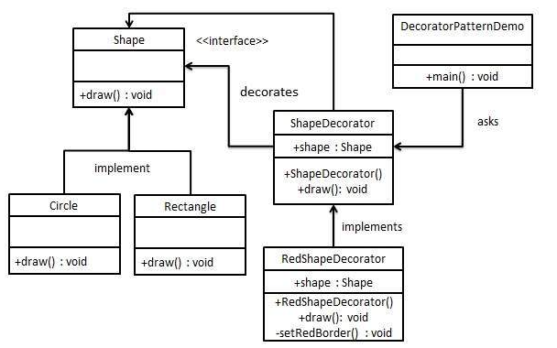
UML\Structure for Decorator Design Pattern

Slide 70
Implementation of (Decorator Design Pattern)
We are demonstrating the use of decorator pattern via following example in which we will decorate a shape with some color without alter shape class.
We're going to create a Shape interface and concrete classes implementing the Shape interface. We will then create an abstract decorator class ShapeDecorator implementing the Shape interface and having Shape object as its instance variable.
RedShapeDecorator is concrete class implementing ShapeDecorator.
DecoratorPatternDemo, our demo class will use RedShapeDecorator to decorate Shape objects.

Slide 71
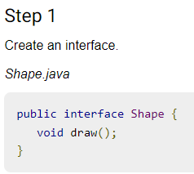
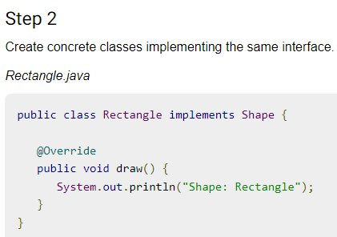
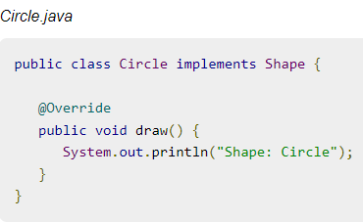
Implementation of (Decorator Design Pattern)

Slide 72
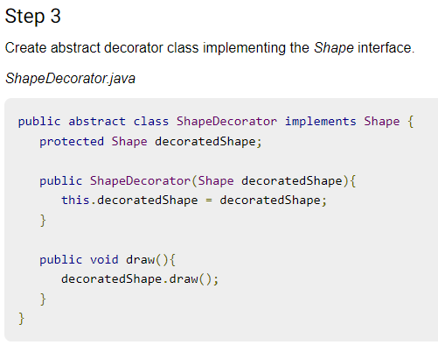
Implementation of (Decorator Design Pattern)

Slide 73

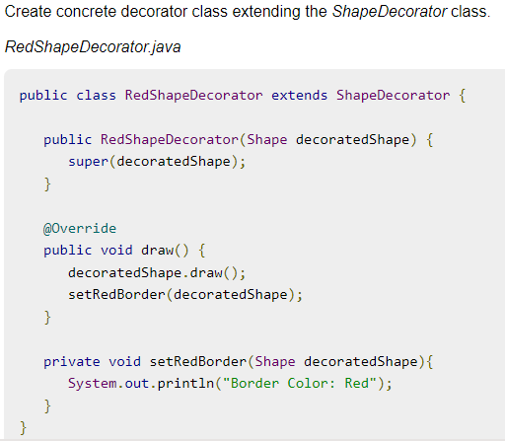
Implementation of (Decorator Design Pattern)

Slide 74
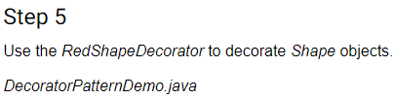
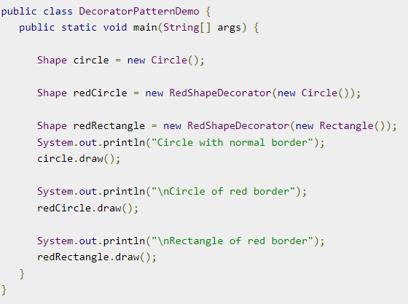
Implementation of (Decorator Design Pattern)

Slide 75
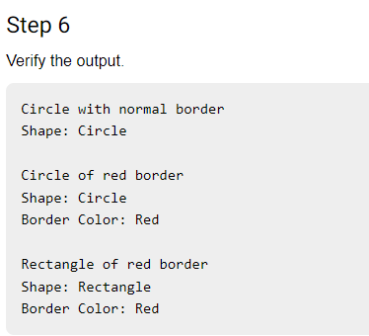
Implementation of (Decorator Design Pattern)

Slide 76
Topic Objective
Topic : Structural Pattern II (Decorator Pattern)
In this topic, the students will gain , The idea of a Structural design pattern, A Decorator Pattern says that just "attach a flexible additional responsibilities to an object dynamically".

Slide 77
Topic Objective
Topic : Structural Pattern II (Facade Pattern)
In this topic, the students will gain , The idea of a Structural design pattern, A Facade Pattern says that just "just provide a unified and simplified interface to a set of interfaces in a subsystem, therefore it hides the complexities of the subsystem from the client".

Slide 78
Structural patterns II (Facade Pattern)
Facade Design Pattern:-
A Facade Pattern says that just "just provide a unified and simplified interface to a set of interfaces in a subsystem, therefore it hides the complexities of the subsystem from the client".
In other words, Facade Pattern describes a higher-level interface that makes the sub-system easier to use.
Practically, every Abstract Factory is a type of Facade.
Facade pattern hides the complexities of the system and provides an interface to the client using which the client can access the system.

Slide 79
Structural patterns (Facade Design Pattern)
Advantage of Facade Design Pattern:-
It shields the clients from the complexities of the sub-system components.
It promotes loose coupling between subsystems and its clients.
Usage of Facade Design Pattern:-
It is used:
When you want to provide simple interface to a complex sub-system.
When several dependencies exist between clients and the implementation classes of an abstraction.

Slide 80

UML\Structure for Facade Design Pattern

Slide 81
Implementation of (Facade Design Pattern)
We are going to create a Shape interface and concrete classes implementing the Shape interface. A facade class ShapeMaker is defined as a next step.
ShapeMaker class uses the concrete classes to delegate user calls to these classes. FacadePatternDemo, our demo class, will use ShapeMaker class to show the results.
This pattern involves a single class which provides simplified methods required by client and delegates calls to methods of existing system classes.

Slide 82

Implementation of (Facade Design Pattern)

Slide 83



Implementation of (Facade Design Pattern)

Slide 84


Implementation of (Facade Design Pattern)

Slide 85


Implementation of (Facade Design Pattern)

Slide 86
Structural patterns II (Flyweight Pattern)
Flyweight Design Pattern:-
A Flyweight Pattern says that just "to reuse already existing similar kind of objects by storing them and create new object when no matching object is found".
Flyweight pattern is primarily used to reduce the number of objects created and to decrease memory footprint and increase performance. This type of design pattern comes under structural pattern as this pattern provides ways to decrease object count thus improving the object structure of application.
Only 5 colors are available so color property is used to check already existing Circle objects.

Slide 87
Structural patterns (Flyweight Design Pattern)
Advantage of Flyweight Design Pattern:-
It reduces the number of objects.
It reduces the amount of memory and storage devices required if the objects are persisted
Usage of Flyweight Design Pattern:-
It is used:
When an application uses number of objects
When the storage cost is high because of the quantity of objects.
When the application does not depend on object identity.

Slide 88

UML\Structure for Flyweight Design Pattern

Slide 89
Implementation of (Flyweight Design Pattern)
We are going to create a Shape interface and concrete class Circle implementing the Shape interface. A factory class ShapeFactory is defined as a next step.
ShapeFactory has a HashMap of Circle having key as color of the Circle object. Whenever a request comes to create a circle of particular color to ShapeFactory, it checks the circle object in its HashMap, if object of Circle found, that object is returned otherwise a new object is created, stored in hashmap for future use, and returned to client.
FlyWeightPatternDemo, our demo class, will use ShapeFactory to get a Shape object. It will pass information (red / green / blue/ black / white) to ShapeFactory to get the circle of desired color it needs.

Slide 90


Implementation of (Flyweight Design Pattern)

Slide 91


Implementation of (Flyweight Design Pattern)
Step 2 cont…….

Slide 92


Implementation of (Flyweight Design Pattern)

Slide 93


Implementation of (Flyweight Design Pattern)

Slide 94

Implementation of (Flyweight Design Pattern)

Slide 95
Structural patterns II (Proxy Pattern)
Proxy Design Pattern:-
Simply, proxy means an object representing another object.According to GoF, a Proxy Pattern "provides the control for accessing the original object".
So, we can perform many operations like hiding the information of original object, on demand loading etc.Proxy pattern is also known as Surrogate or Placeholder.
In proxy pattern, a class represents functionality of another class. This type of design pattern comes under structural pattern.
In proxy pattern, we create object having original object to interface its functionality to outer world.

Slide 96
Structural patterns (Proxy Design Pattern)
Advantage of Proxy Design Pattern:-
It provides the protection to the original object from the outside world.
Usage of Proxy Design Pattern:-
It is used:
It can be used in Virtual Proxy scenario---Consider a situation where there is multiple database call to extract huge size image.
It can be used in Protective Proxy scenario---It acts as an authorization layer to verify that whether the actual user has access the appropriate content or not.

Slide 97

UML\Structure for Proxy Design Pattern

Slide 98
Implementation of (Proxy Design Pattern)
We are going to create an Image interface and concrete classes implementing the Image interface. ProxyImage is a a proxy class to reduce memory footprint of RealImage object loading.
ProxyPatternDemo, our demo class, will use ProxyImage to get an Image object to load and display as it needs.
In proxy pattern, a class represents functionality of another class. This type of design pattern comes under structural pattern.

Slide 99



Implementation of (Proxy Design Pattern)

Slide 100

Implementation of (Proxy Design Pattern)
Step -2 Cont.……..

Slide 101


Implementation of (Proxy Design Pattern)

Slide 102
Daily Quiz
You want to minimize development cost by reusing methods? Which design pattern would you choose?
Adapter Pattern
Singleton Pattern
Delegation pattern
Immutable Pattern
Which design pattern defines one-to-many dependency among objects?
Singleton pattern
Facade Pattern
Observer pattern
Factory method pattern

Slide 103
Daily Quiz
Which design pattern suggest multiple classes through which request is passed and multiple but only relevant classes carry out operations on the request.
Singleton pattern
Chain of responsibility pattern
State pattern
Bridge pattern
Most user interface design patterns fall with in one of ____ categories of patterns.
5
10
25
100

Slide 104
Weekly Assignment
What are Design Patterns in Java? What are the types of design patterns in Java.
What are the Structural Patterns and What Is Façade Pattern.
What Is Flyweight Design Pattern.
Explain Facade Pattern in Java.
5. Explain the Proxy pattern.

Slide 105
Topic Link ( YouTube & NPTEL Video Links)
YouTube /other Video Links
https://youtu.be/rI4kdGLaUiQ?list=PL6n9fhu94yhUbctIoxoVTrklN3LMwTCmd
https://youtu.be/v9ejT8FO-7I?list=PLrhzvIcii6GNjpARdnO4ueTUAVR9eMBpc
https://youtu.be/VGLjQuEQgkI?list=PLt4nG7RVVk1h9lxOYSOGI9pcP3I5oblbx

Slide 106
MCQ
1. Design patterns can be classified in _______ categories.
1
2
3
4
2. Which design patterns are specifically concerned with communication between objects?
Creational Patterns
Structural Patterns
Behavioral Patterns
J2EE Patterns

Slide 107
MCQ
3. Which design pattern provides a single class which provides simplified methods required by client and delegates call to those methods?
Adapter pattern
Builder pattern
Facade pattern
Prototype pattern
4. Which design pattern suggests multiple classes through which request is passed and multiple but only relevant classes carry out operations on the request?
Singleton pattern
Chain of responsibility pattern
State pattern
Bridge pattern

Slide 108
Glossary Questions
Top 10 design pattern interview questions
What are design patterns?
How are design patterns categorized?
Explain the benefits of design patterns in Java.
Describe the factory pattern.
Differentiate ordinary and abstract factory design patterns.
What do you think are the advantages of builder design patterns?
How is the bridge pattern different from the adapter pattern?
What is a command pattern?
Describe the singleton pattern along with its advantages and disadvantages.
What are anti patterns?

Slide 109
Expected Questions for University Exam
What are design patterns?
How are design patterns categorized?
Explain the benefits of design patterns in Java.
Describe the factory pattern.
Differentiate ordinary and abstract factory design patterns.
What do you think are the advantages of builder design patterns?
How is the bridge pattern different from the adapter pattern?
What is a command pattern?
Describe the singleton pattern along with its advantages and disadvantages.
What are anti patterns?
Explain proxy design pattern in detail?
Explain the features of structural pattern?
Explain the advantages and disadvantages of structural patterns?
Illustrate the uses of Adapter Patterns?
What are the advantages of Composite design Pattern in Java?

Slide 110
Summary
Till Now we understand, The idea of a Structural design pattern, It concerned with how classes and objects can be composed, to form larger structures. The structural design patterns simplifies the structure by identifying the relationships.
A Facade Pattern says that just "just provide a unified and simplified interface to a set of interfaces in a subsystem, therefore it hides the complexities of the subsystem from the client".
You also learn, a Proxy Pattern "provides the control for accessing the original object".
A Flyweight Pattern says that just "to reuse already existing similar kind of objects by storing them and create new object when no matching object is found".

Slide 111
References
Eric Freeman, Elisabeth Freeman, Kathy Sierra, Bert Bates Head First Design Patterns, 2004, O'Reilly.
Erich Gamma, Richard Helm, Ralph Johnson, John Vlissides Design Patterns: Elements of Reusable Object-oriented Software Addison-Wesley, 1995.
Design Pattern s By Erich Gamma , Pearson Education, 2001.
Patterns in JAVA Volume -I By Mark Grand, Wiley Dream.2002.
Patterns of Enterprise Application Architecture , Pearson Education India, 2002.

Slide 112
THANK YOU

